Slide 1

Internship Report
By – Pallavi Kumari
Profile – Application Development Intern
Reg No -12202956
Course code – CAP841

Slide 2

Introduction of the company
Midland Microfin Limited is the first Punjab based NBFC – MFI vide RBI registration number B-06.00458.
Formally started its Business Operations in January 2011.
Working towards the Financial and Social empowerment of women.
Highly Techno Savvy
Currently working in 11 States & 1 Union Territory i.e., Punjab, Haryana, Himachal Pradesh, Rajasthan, Uttar Pradesh, Bihar, Jharkhand, Gujarat, Madhya Pradesh, Uttarakhand, West Bengal and (UT) Chandigarh.
Experienced Promoters and Directors having experience of more than 50-year BFSI sector

Slide 3




Slide 4
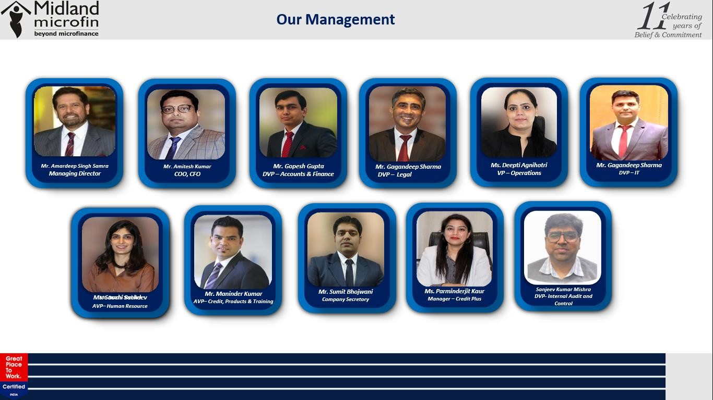

Slide 5




Internship Certificate

Slide 6
About the Project
.
Smart Grader is an online platform dedicated to conducting exams, particularly those that require subjective responses. By leveraging advanced artificial intelligence technologies, the system evaluates the answers provided by candidates. The AI-powered analysis ensures accurate and efficient grading. The results are then displayed on a user-friendly dashboard, providing a comprehensive overview of each candidate's performance. This innovative approach streamlines the exam process, making it more efficient and reliable for both examiners and examinees.

Slide 7

Learning during the internship
SQL
PL/SQL
Worked on MIS, QuickBill and AMS modifications.
Worked on User requirement changes from Backend.
Made Reports for the users requirement.

Slide 8
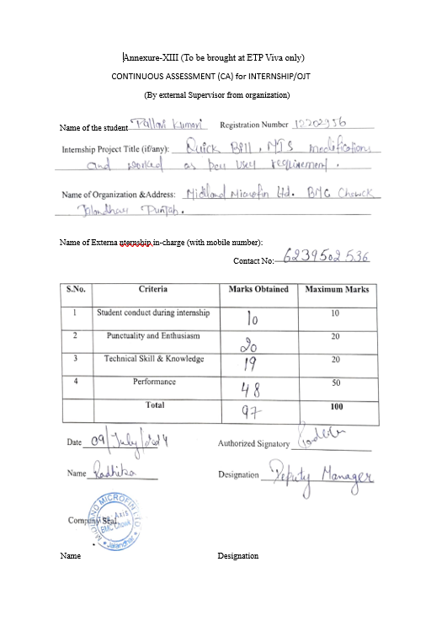
CA Marks

Slide 9
Thank You

